Slide 1
ONLINE RECRUITMENT SYSTEM
Name : R.Kaninsan Joshua
Class: III year CSE
Register Number : 950518104021
Roll Number : 11181021
Guide : Mr. T. Saravana Kumar

Slide 2
ABSTRACT
The population growth resulted in the increase in the number of candidates applying for a job. But the recruiters have a limited number of time and resources . This project tries to address the problem. The job provides a site for candidates to apply for a job and help recruiters to automate the recruitment process. It completes each step of recruitment from send notification to resume classification and ends with chat based interview with a Chatbot. It also provide better experience for the candidates

Slide 3
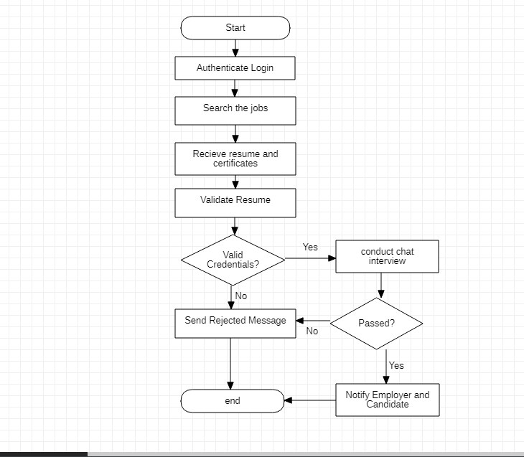
FLOW CHART

Slide 4
TECH STACK
FRONTEND-JAVASCRIPT
BACKEND-MYSQL
PROGRAMMING LANGUAGE- C++

Slide 5


